Slide 1
NDRRMC Monitoring System
Carpio, aira joyce
Haboc, Florence gail
Salazar, arnold

Slide 2


Client
Lead Agency

Slide 3
Problem
Lack of communication and coordination
Lack of capacity and technical expertise
Lack of public awareness or the threats and impacts of all types of hazards
Lack of necessary skills to cope with the impacts of disaster

Slide 4
Objectives
General Objectives
To increase community disaster awareness and improve disaster preparation coordination
Specific Objectives
To enable users to be updated about the reports
To have the users a coordination with each other
To help users in decision-making for disaster preparation and respond

Slide 5
Description
Tracks relevant data from different NDRRMC stand-alone systems (e.g. Logistics, Inventory, Procurement, etc.)
Law and Order sends report
Users receive a notification about the report details

Slide 6
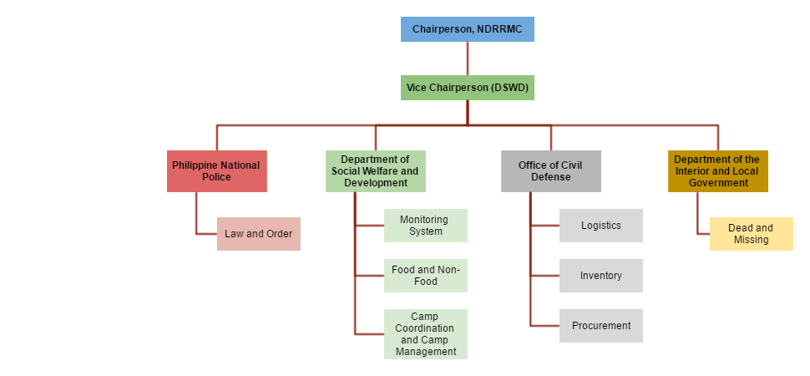
Target User

Slide 7
Scope
The coverage of NDRRMC Monitoring System is the following:
NDRRMC Monitoring System collects the data from different resources or system
NDRRMC Monitoring System data gathered from Law and Order Report will be send to responsible user/s as notification
NDRMMC Monitoring System provides summary reports in form of dashboards using analytic tool

Slide 8
Limitations
Account for LGUs, NDRRMC member agencies, admins of different NDRRMC system
Produce summary reports of the data of each of the system
Report details heavily depends on Law and Order System

Slide 9
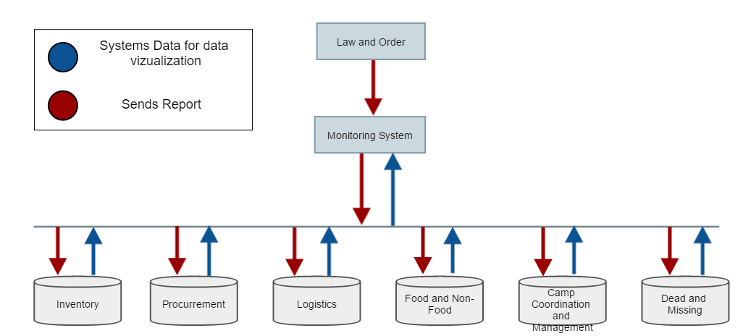
Conceptual Diagram

Slide 10
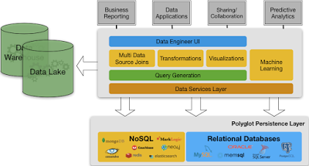
Proposed BI Tool

Slide 11
Technical Background
Ubuntu
MySQL Server & Cassandra Server
Cloud9Agent Server

Slide 12
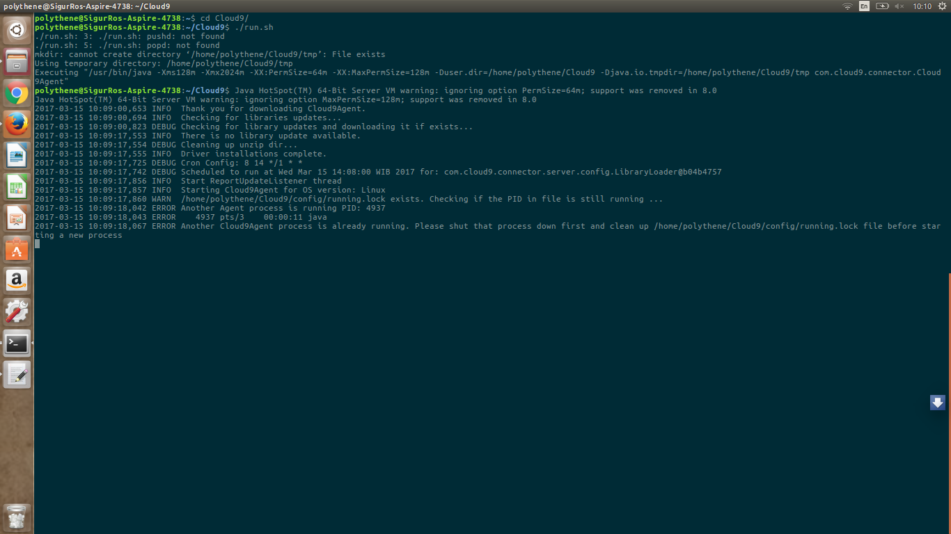

Slide 13
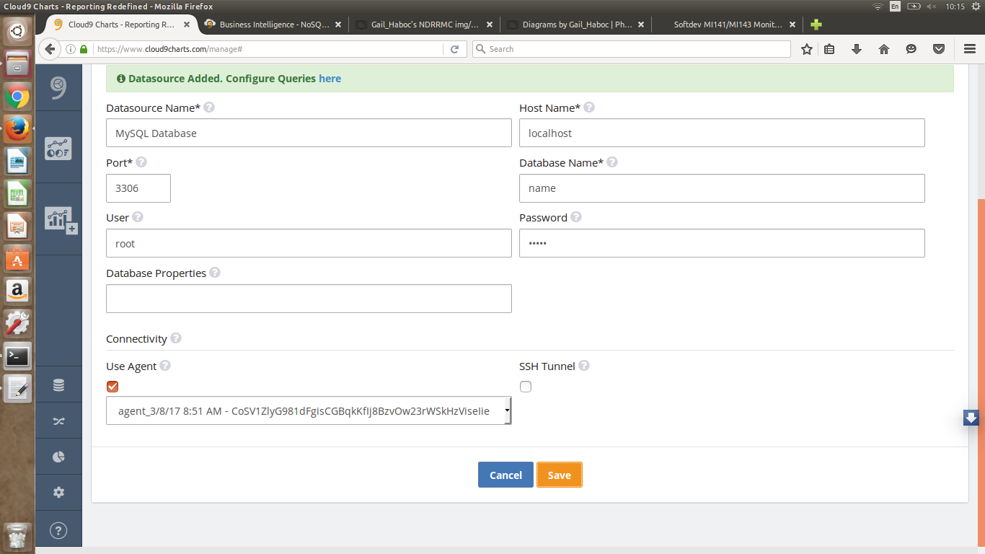

Slide 14
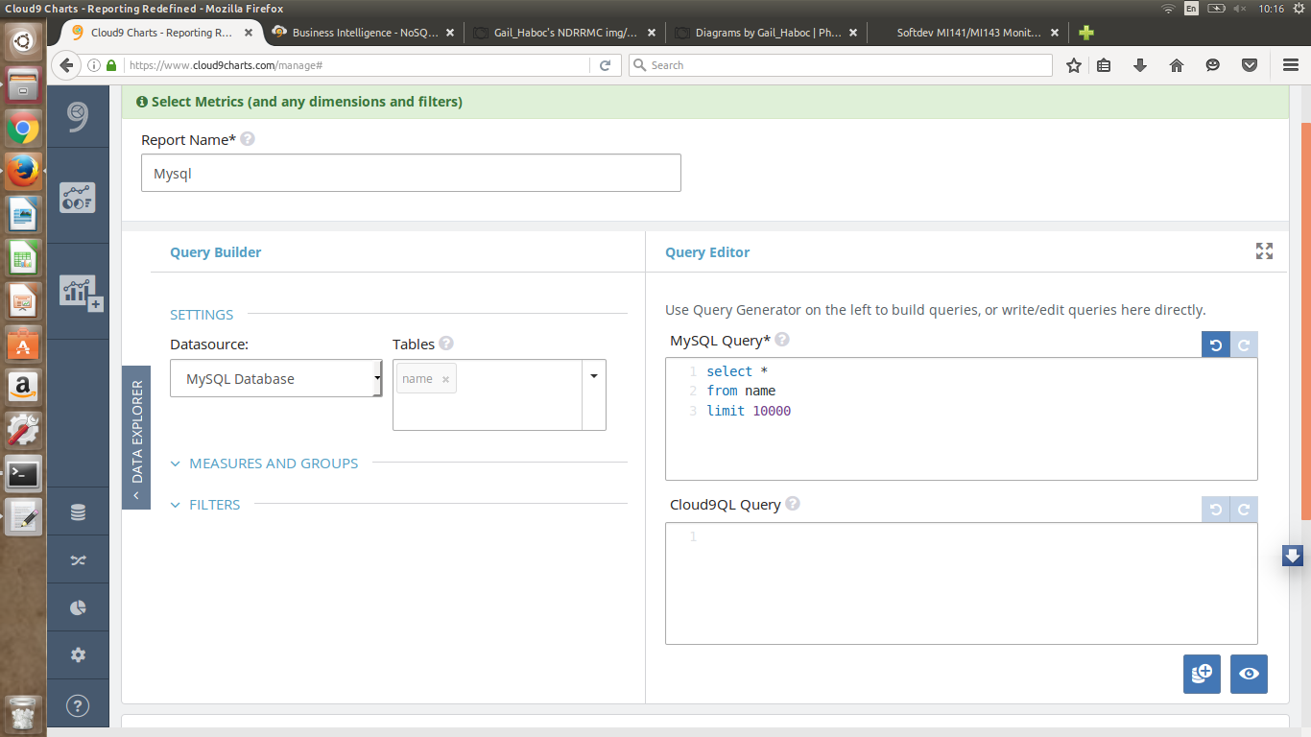

Slide 15
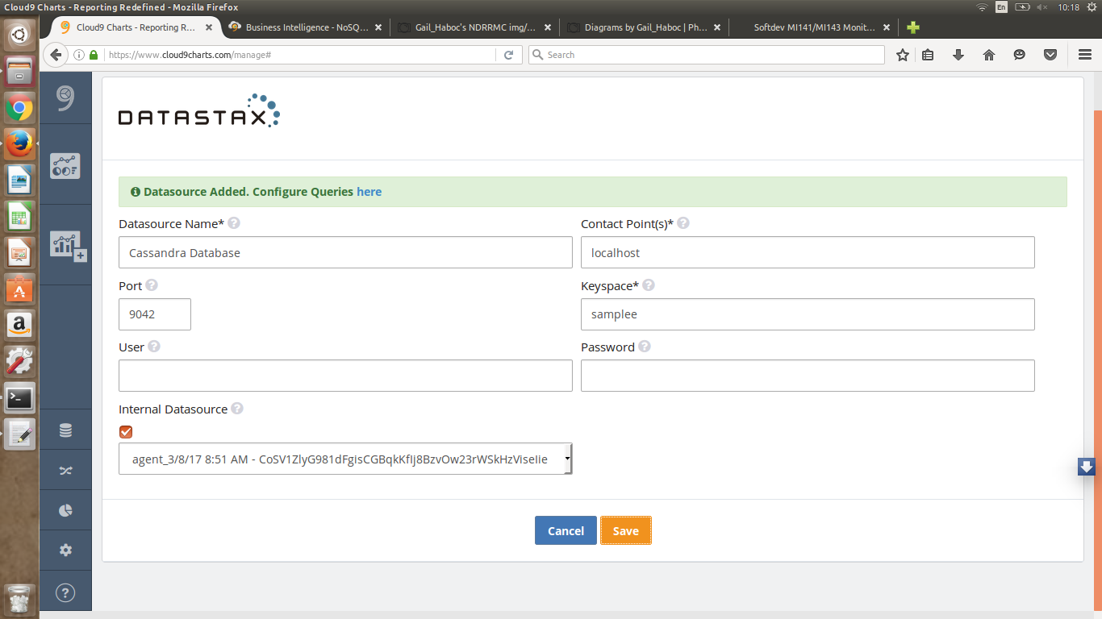

Slide 16
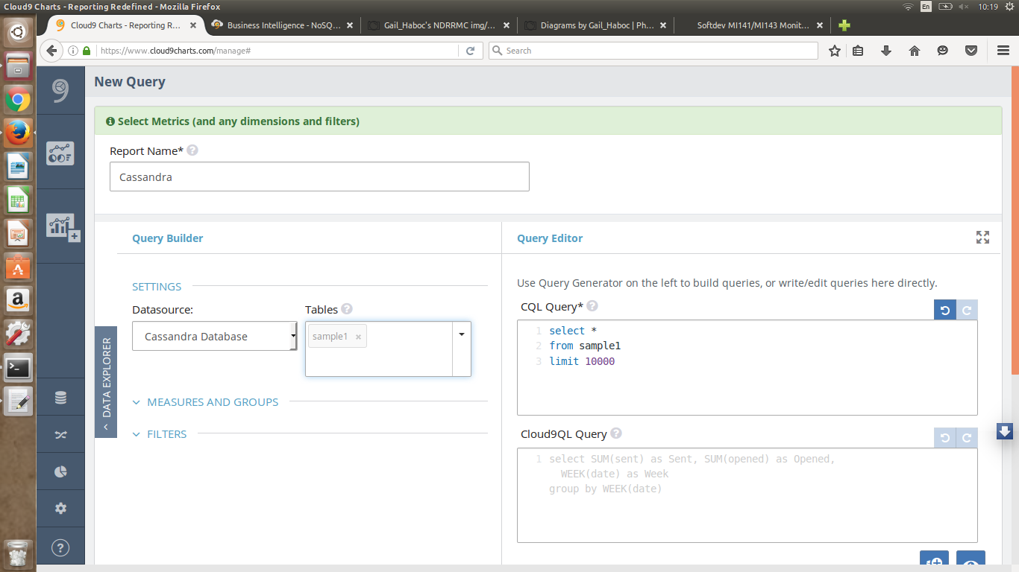

Slide 17
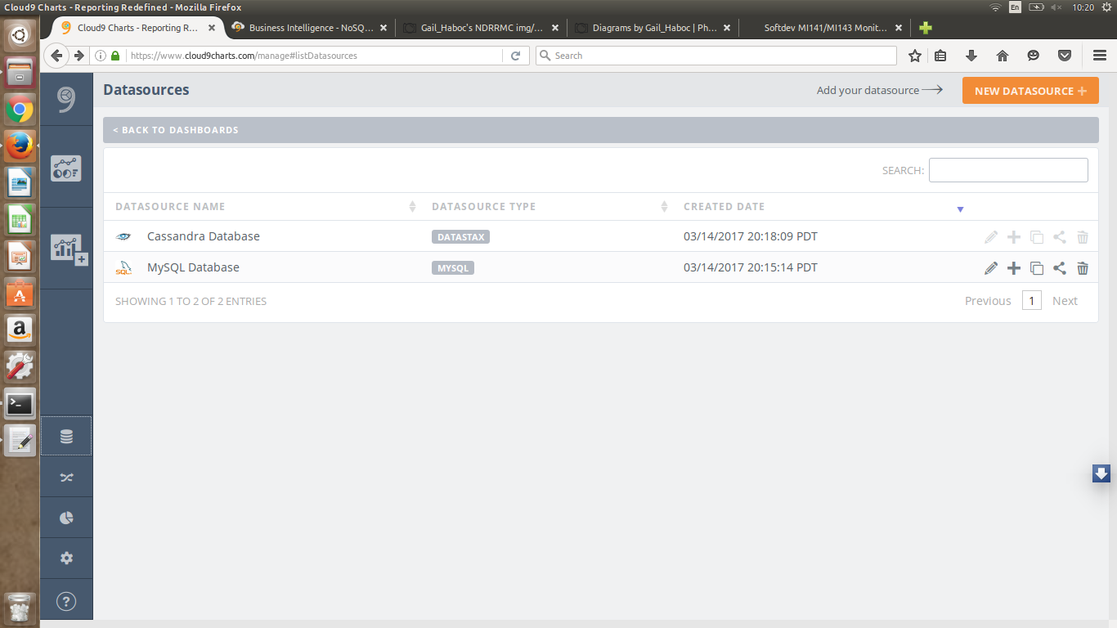

Slide 18
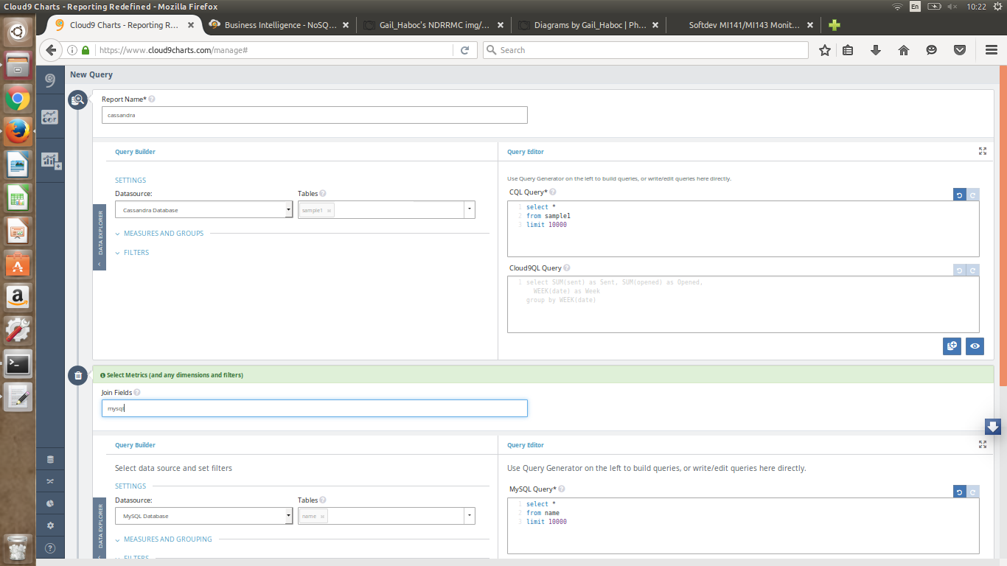

Slide 19
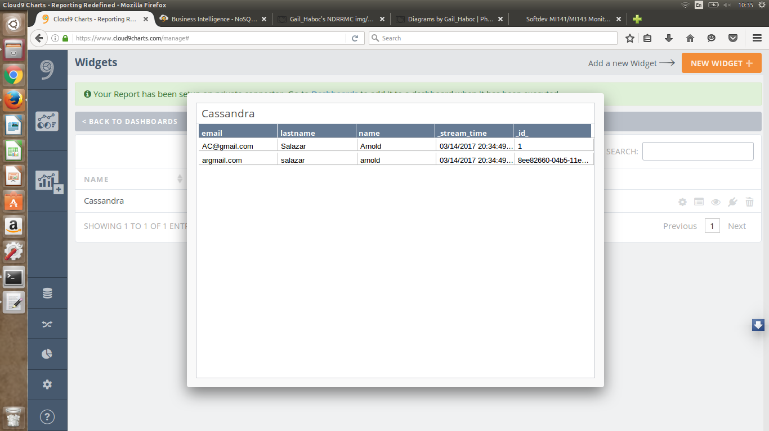

Slide 20
PROTOTYPE

Slide 21
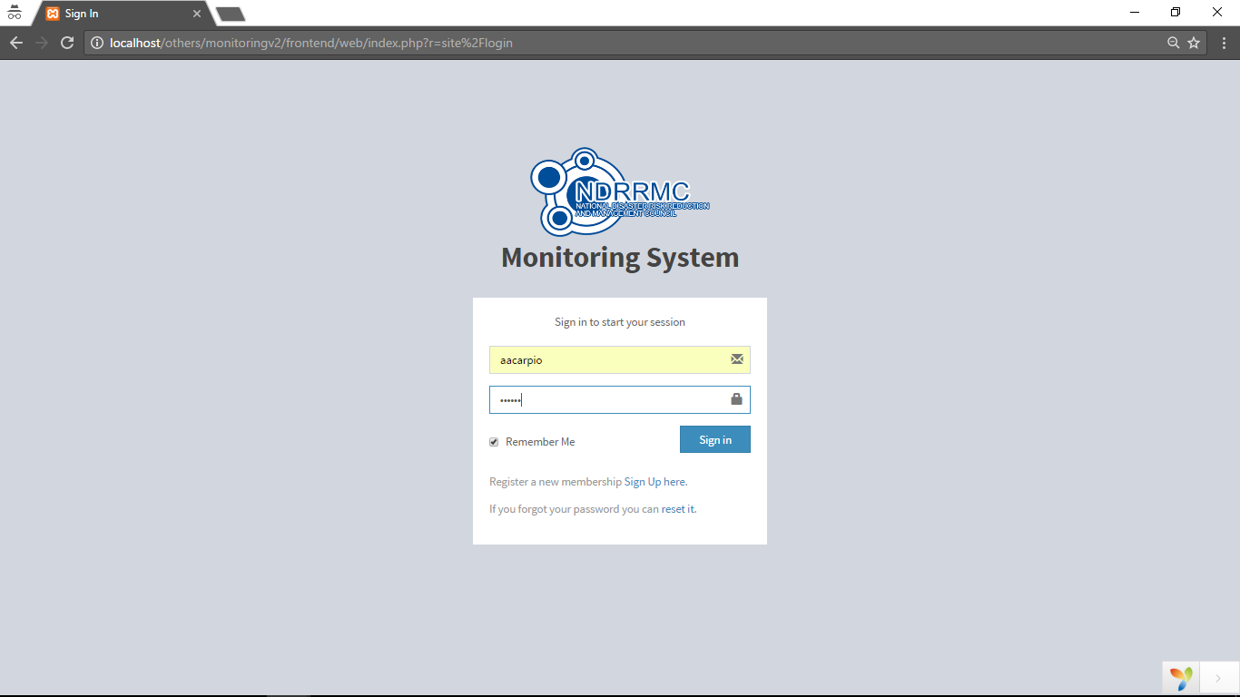

Slide 22
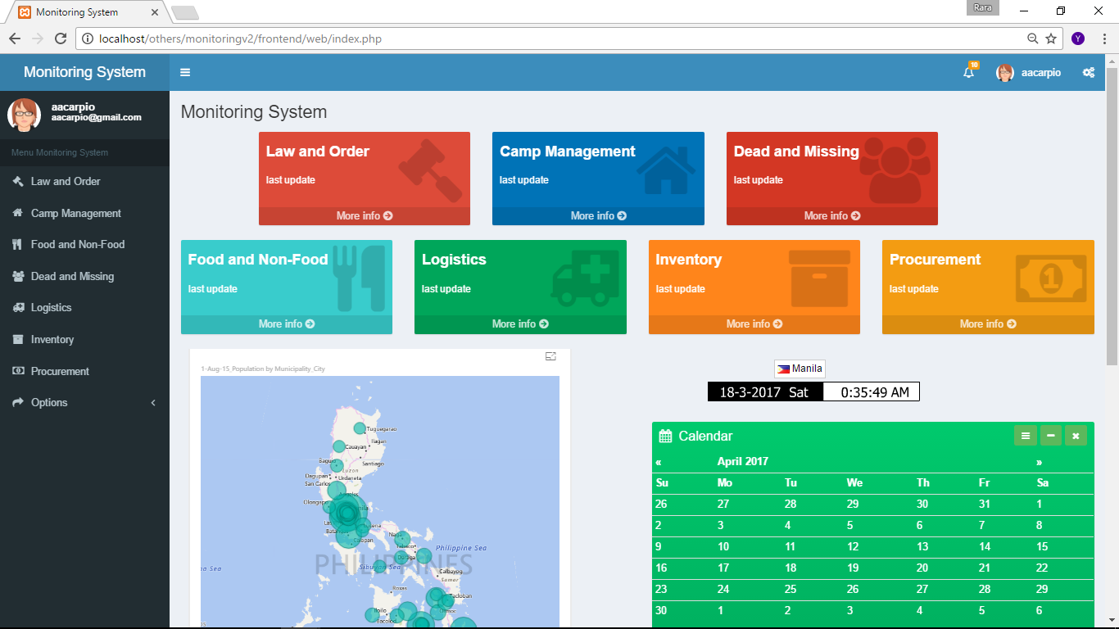

Slide 23
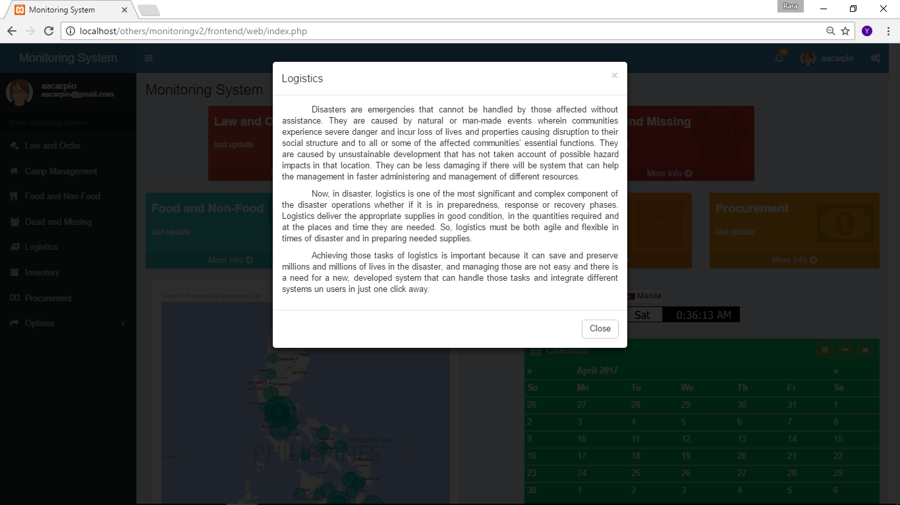

Slide 24
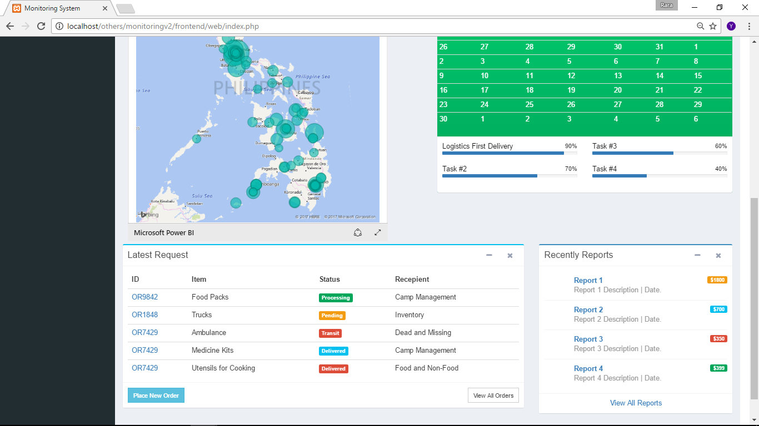

Slide 25
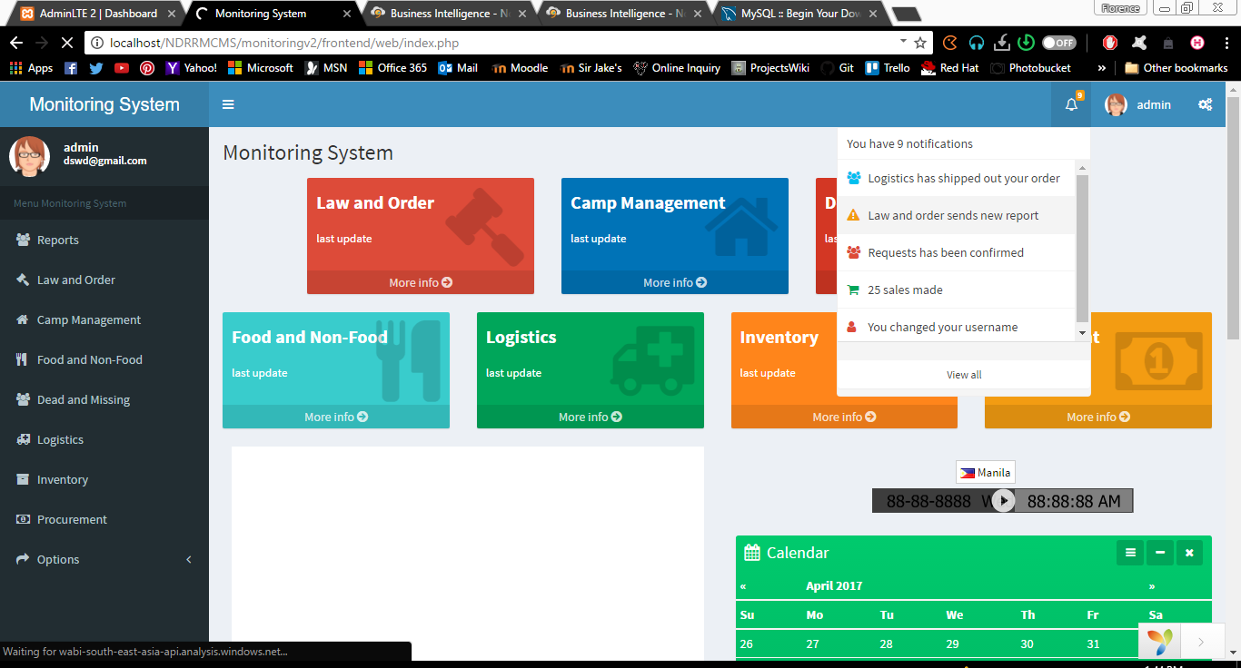

Slide 26
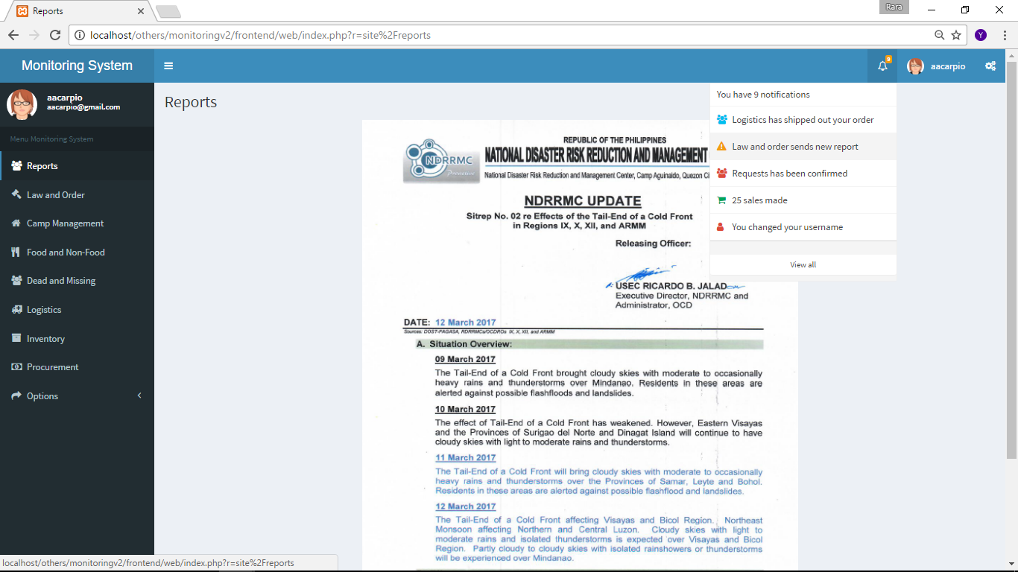

Slide 27
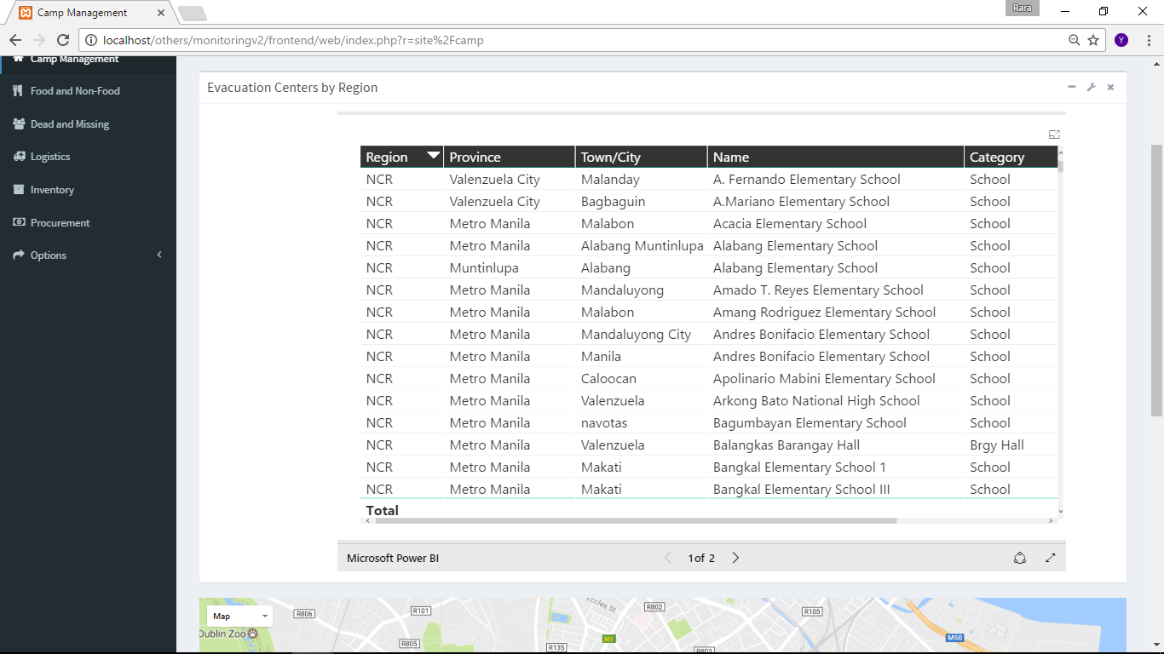

Slide 28
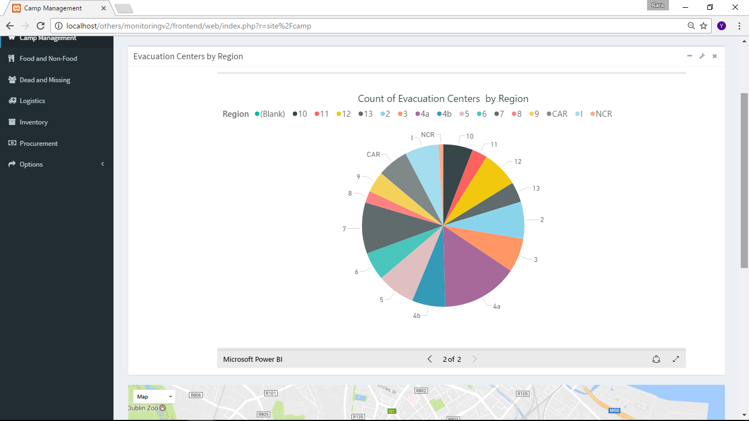

Slide 29
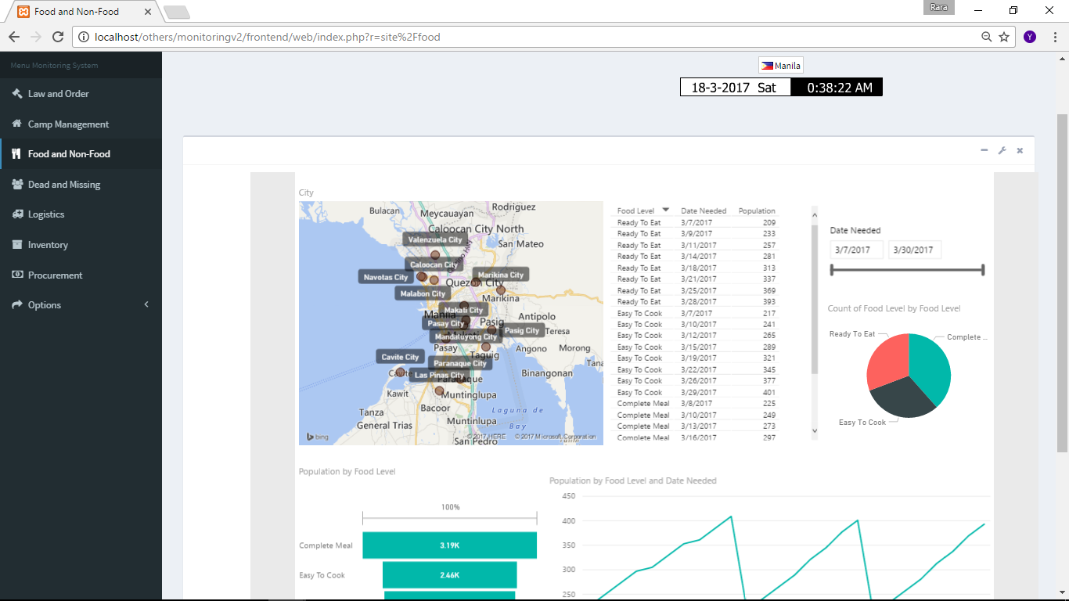

Slide 30
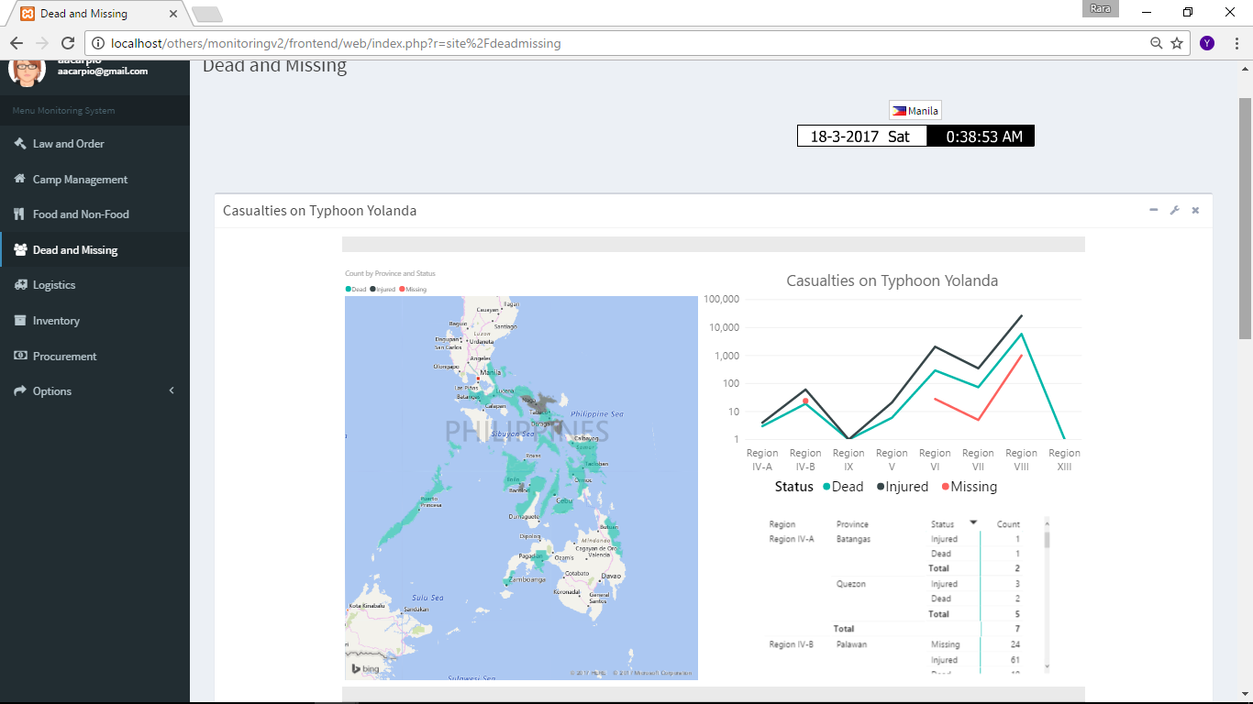

Slide 31
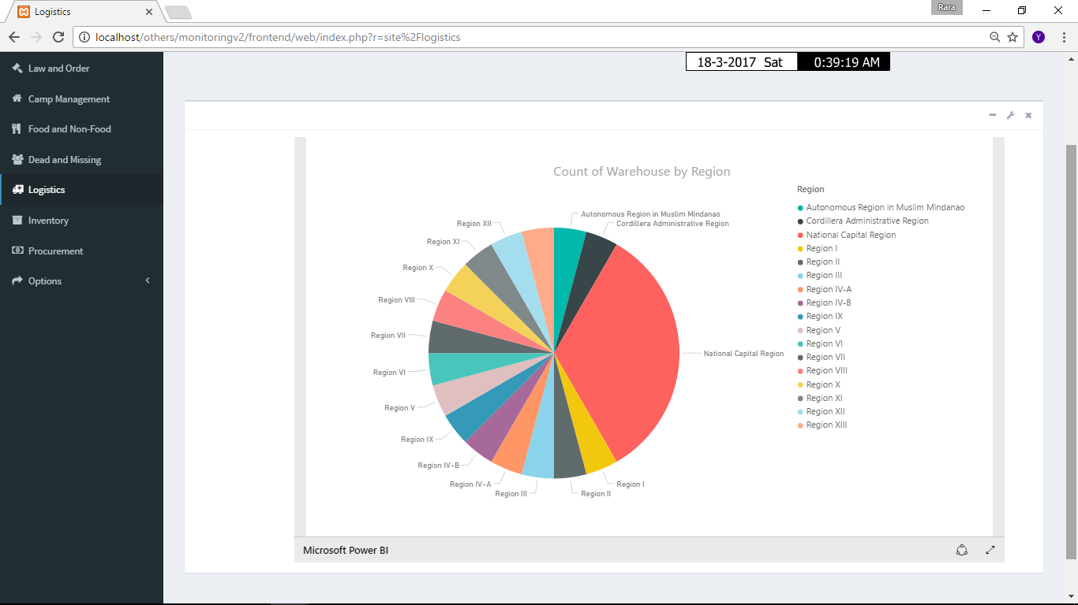

Slide 32
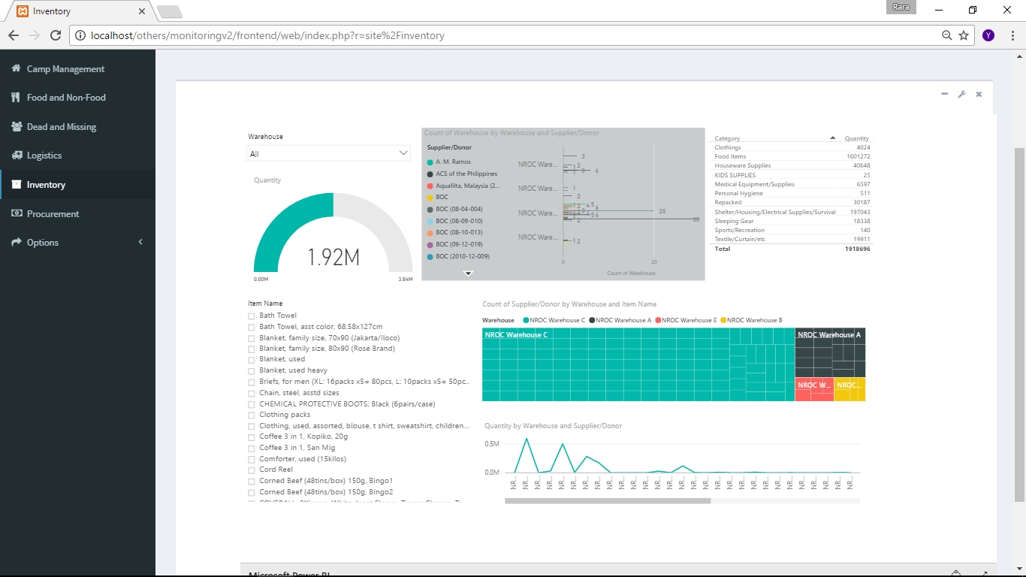

Slide 33
